Slide 1
Part ii: Multidimensional filter
Larissa Driemeier
Thiago Martins

Slide 2
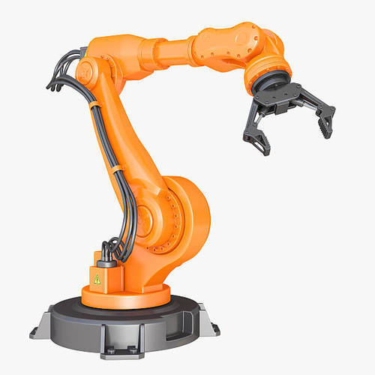
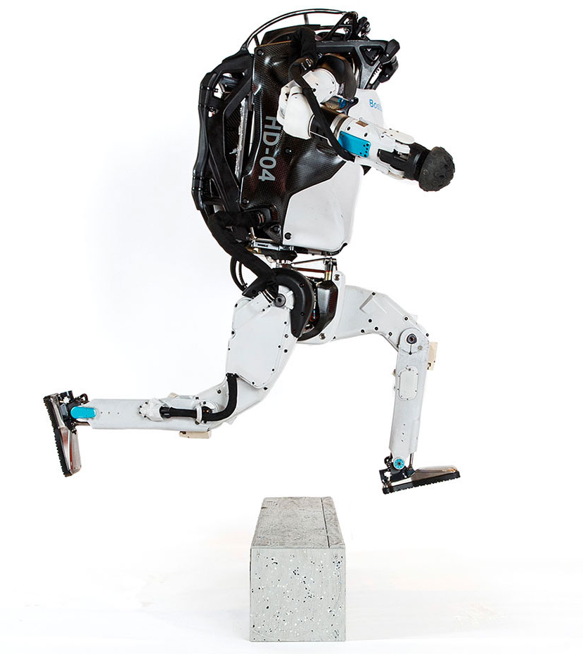
Stationary robots (SRs):
They are the manipulators and industrial robots. The base is fixed, and the robot has an open kinematic chain, mainly with an end-effector. In general, they are automated, programmable and with many degrees of freedom. As an example, to position the tool mounted on the end of the robot at any place and at any angle requires six degrees of freedom.

Slide 3
Mobile robots (MRs):
Controlled by software, use sensors and other technologies to understand its surroundings
and move through the environment. They have ability to move autonomously, with enough intelligence to react and make decisions. They can be land-based, air-based, water-based, hybrid...

Slide 4
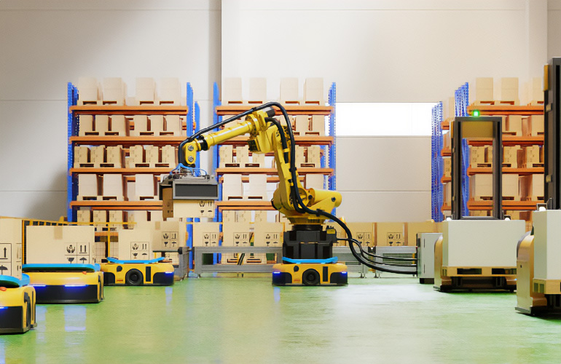

Slide 5
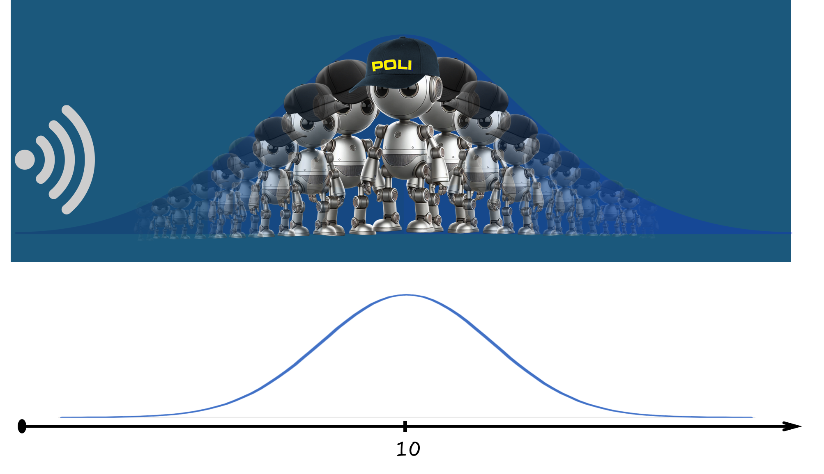
The sensor is not perfect. A reading of 10.0 may correspond to positions 10.4 or 9.6. However, it is very unlikely to correspond to a position of 25.

Slide 6
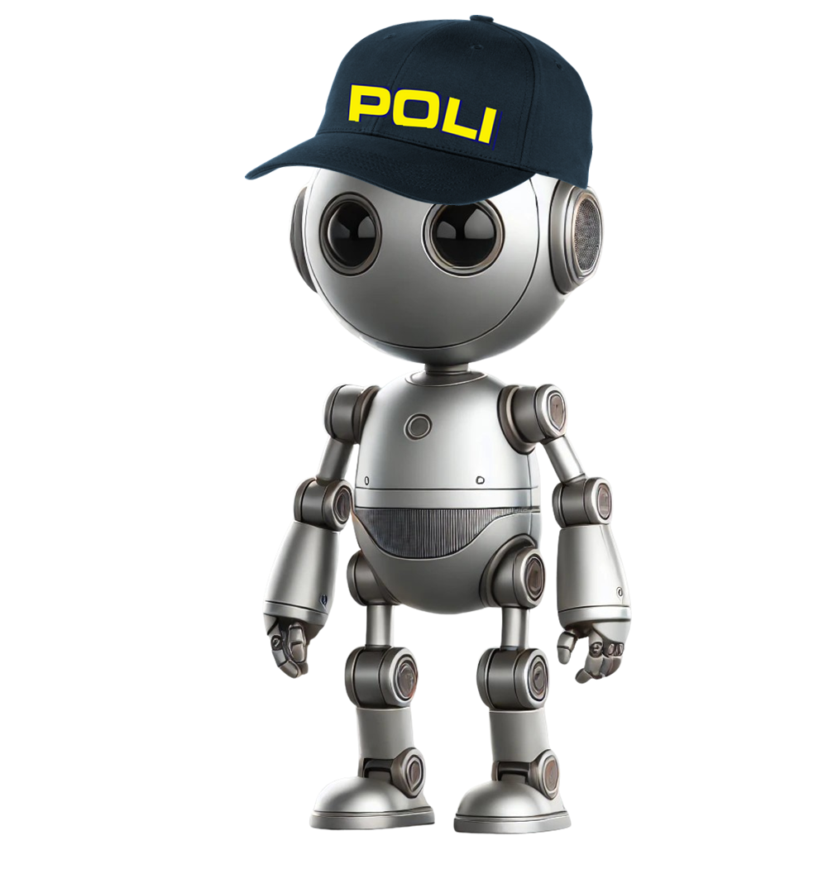

Unlikely Very likely
We don't know what the actual position and velocity are, but there are a whole range of possible combinations of position and velocity that could be true... some of them are more likely than others.
position
Some state that might be true
velocity

Slide 7
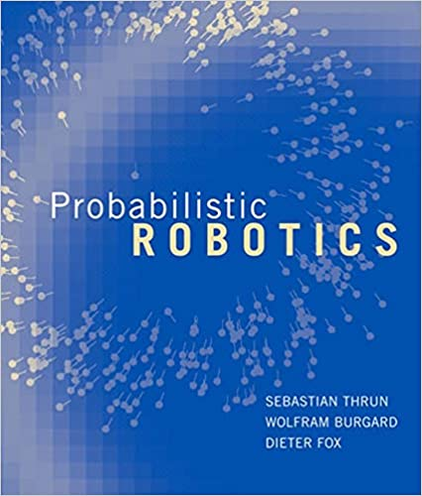

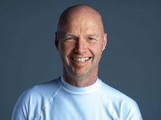
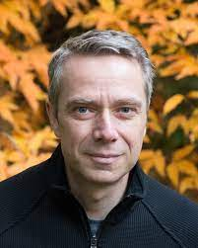
Why?
What are the advantages of programming robots probabilistically, when compared to other approaches that do not explicitly represent uncertainty?
Our central conjecture is nothing less than the following:
A robot that carries a sense of its own uncertainty and acts accordingly is superior to one that does not.

Slide 8
Pre-class review

Slide 9
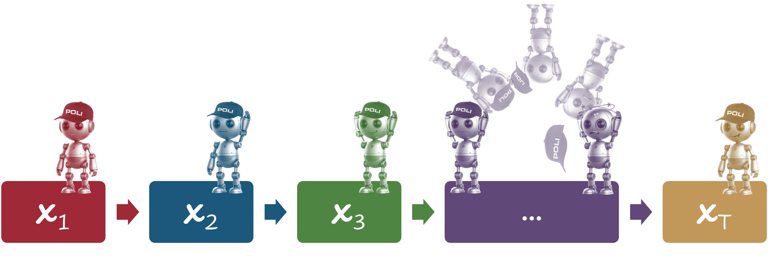
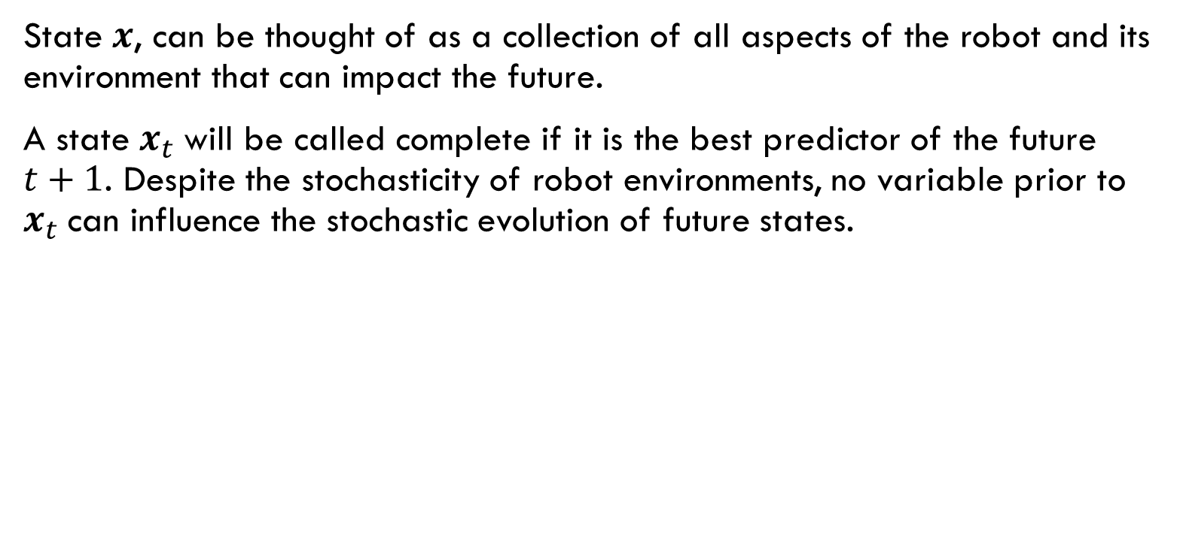
Estado
State $x$, can be thought of as a collection of all aspects of the robot and its environment that can impact the future.
A state $x_{t}$will be called complete if it is the best predictor of the future $t+1$. Despite the stochasticity of robot environments, no variable prior to $x_{t}$can influence the stochastic evolution of future states.
Discrete temporal processes that meet these conditions are commonly known as Markov chains.

Slide 10
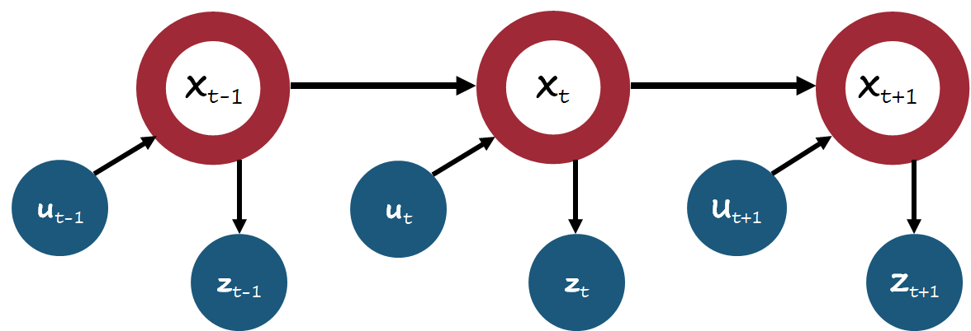
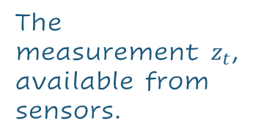
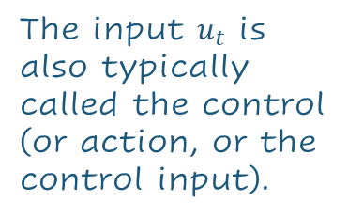
STATE
The input $u_{t}$ is also typically called the control (or action, or the control input).
The measurement $z_{t}$, available from sensors.
Discrete temporal processes that meet these conditions are commonly known as Markov chains.

Slide 11
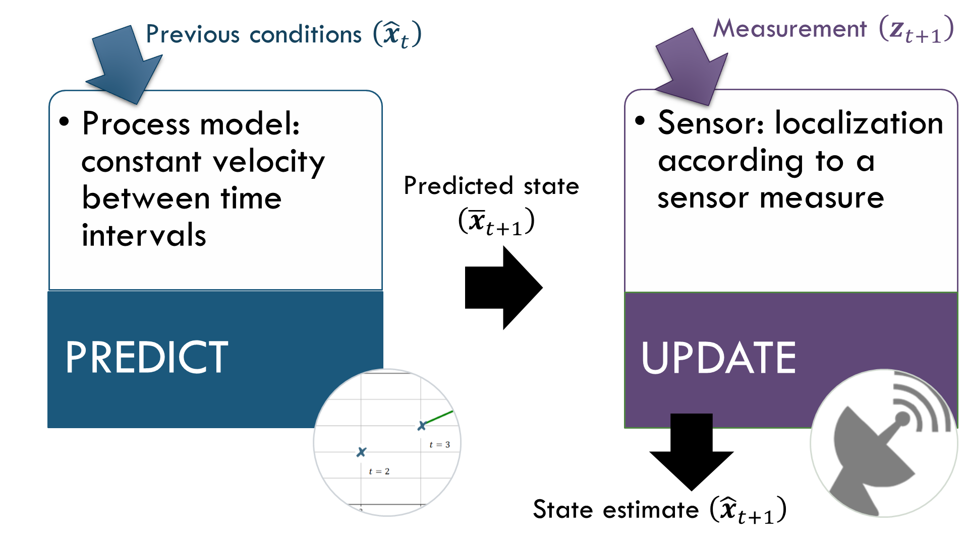

Slide 12
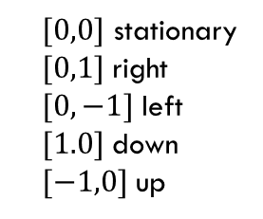
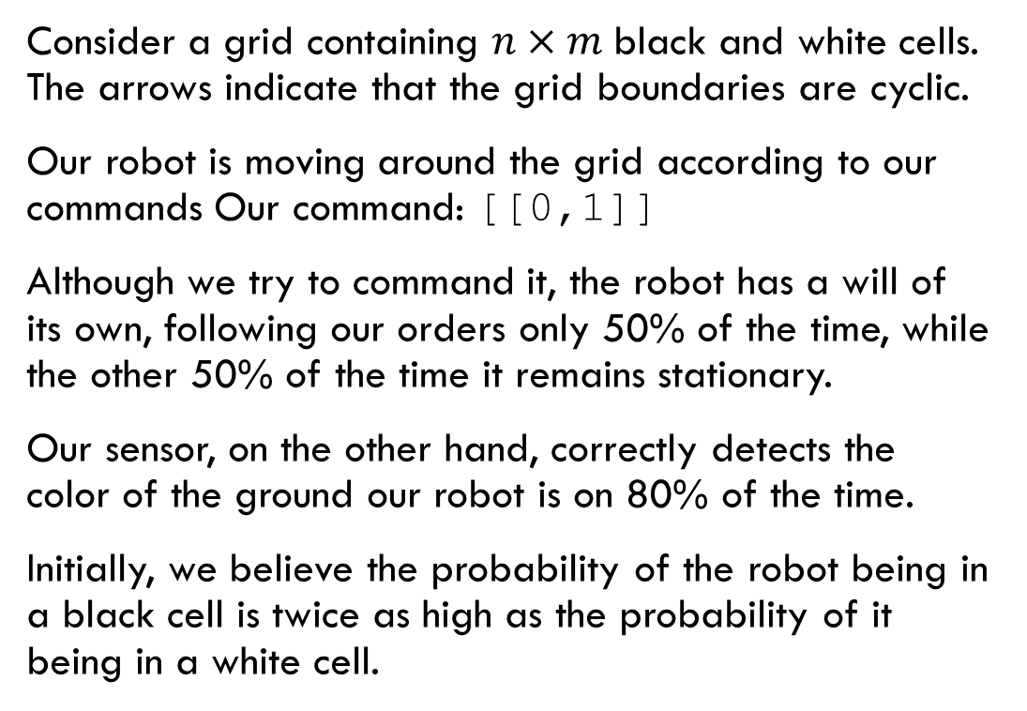
Let's understand through examples...
Consider a grid containing $n×m$black and white cells. The arrows indicate that the grid boundaries are cyclic.
Our robot is moving around the grid according to our commands Our command: [[0,1]]
Although we try to command it, the robot has a will of its own, following our orders only 50% of the time, while the other 50% of the time it remains stationary.
Our sensor, on the other hand, correctly detects the color of the ground our robot is on 80% of the time.
Initially, we believe the probability of the robot being in a black cell is twice as high as the probability of it being in a white cell.
[0,0] | [0,1]
[1,0]
0.125 0.125 0.125
0.125 0.0625 0.0625
$[0,0]$ stationary
$[0,1]$right
$[0, −1]$left
$[1.0]$down
$[−1,0]$up
0.125 0.125 0.125

Slide 13

[0,1]: right
Looking only for these cells
The prediction state is based on a process model. Our process model is defined according to the probability that the robot will move according to our commands.
[0,0] | [0,1]
[1,0]
[1,0] | [1,1]
0.125 0.125 0.125
0.125 0.0625
0.5x0.125+0.5x0.0625
0.09375 0.09375 0.0625
[1,0] | [1,1]
$[0,0]$ stationary
$[0,1]$right
$[0, −1]$left
$[1.0]$down
$[−1,0]$up
0.09375 0.09375
0.125 0.125 0.125

Slide 14
Sensor: ‘W’
Looking only for these cells
[0,0] | [0,1]
[1,0]
[1,0] | [1,1]
0.08511 0.08511 0.08511
0.09375 0.09375
0.09375x0.2 = 0.01875 (/0.29375 = 0.0638)
0.09375x0.8=0.075 (/0.29375 = 0.25532)
0.06383 0.025532 0.17021
[1,0] | [1,1]
$[0,0]$ stationary
$[0,1]$right
$[0, −1]$left
$[1.0]$down
$[−1,0]$up
0.01875 0.25532
0.08511 0.08511 0.08511

Slide 15
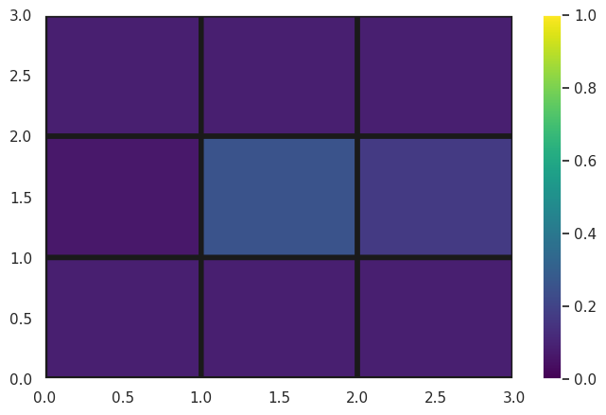
P
0.08511 0.08511 0.08511
0.06383 0.025532 0.17021
0.08511 0.08511 0.08511

Slide 16
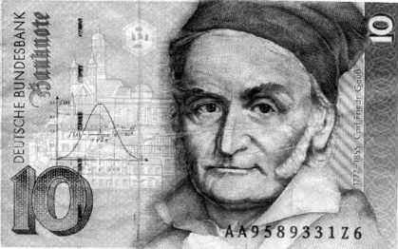
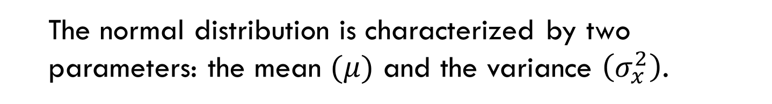
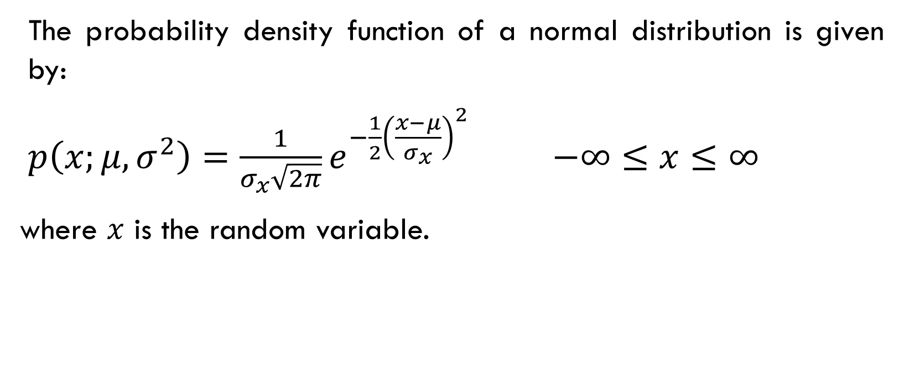
NORMAL distribution
The probability density function of a normal distribution is given by:
$p\left(x;μ,σ^{2}\right)=\frac{1}{σ_{x}\sqrt{2π}}e^{−\frac{1}{2}{\left(\frac{x−μ}{σ_{x}}\right)}^{2}}$ $−∞≤x≤∞$
where $x$ is the random variable.
The normal distribution is characterized by two parameters: the mean $(μ)$ and the variance $\left(σ_{x}^{2}\right)$.

Slide 17
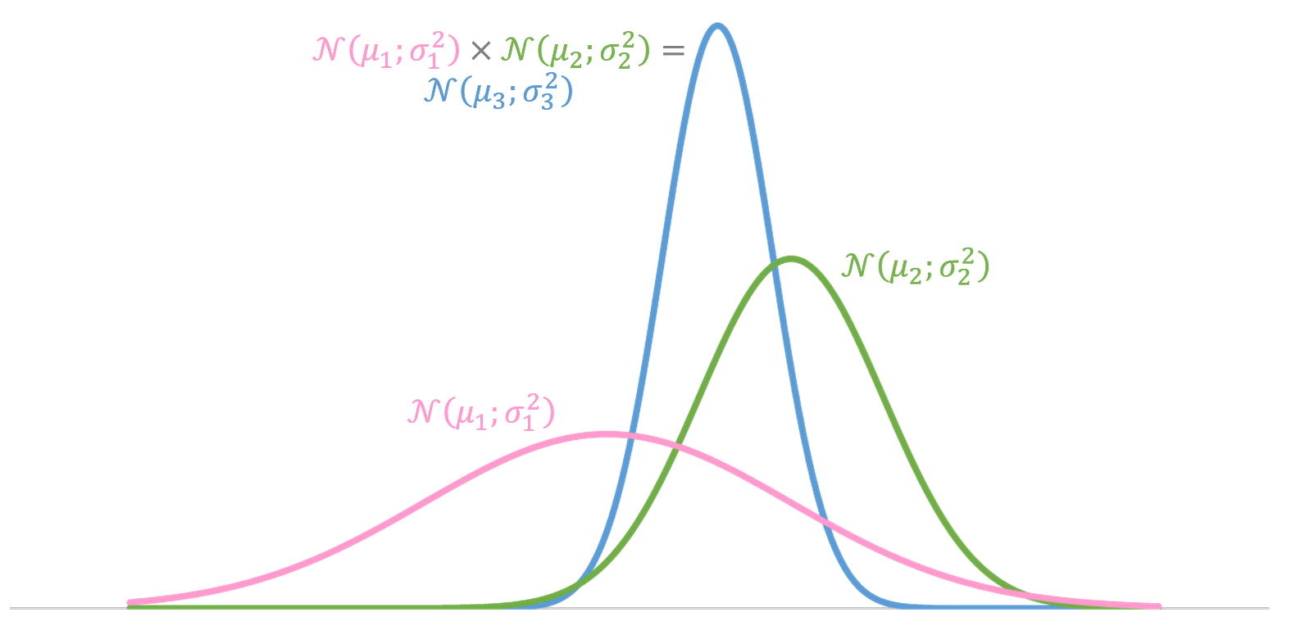
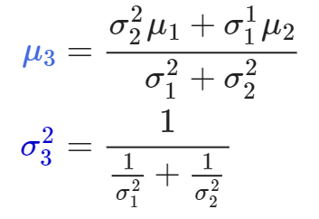
the product of the gaussians are gaussians

Slide 18
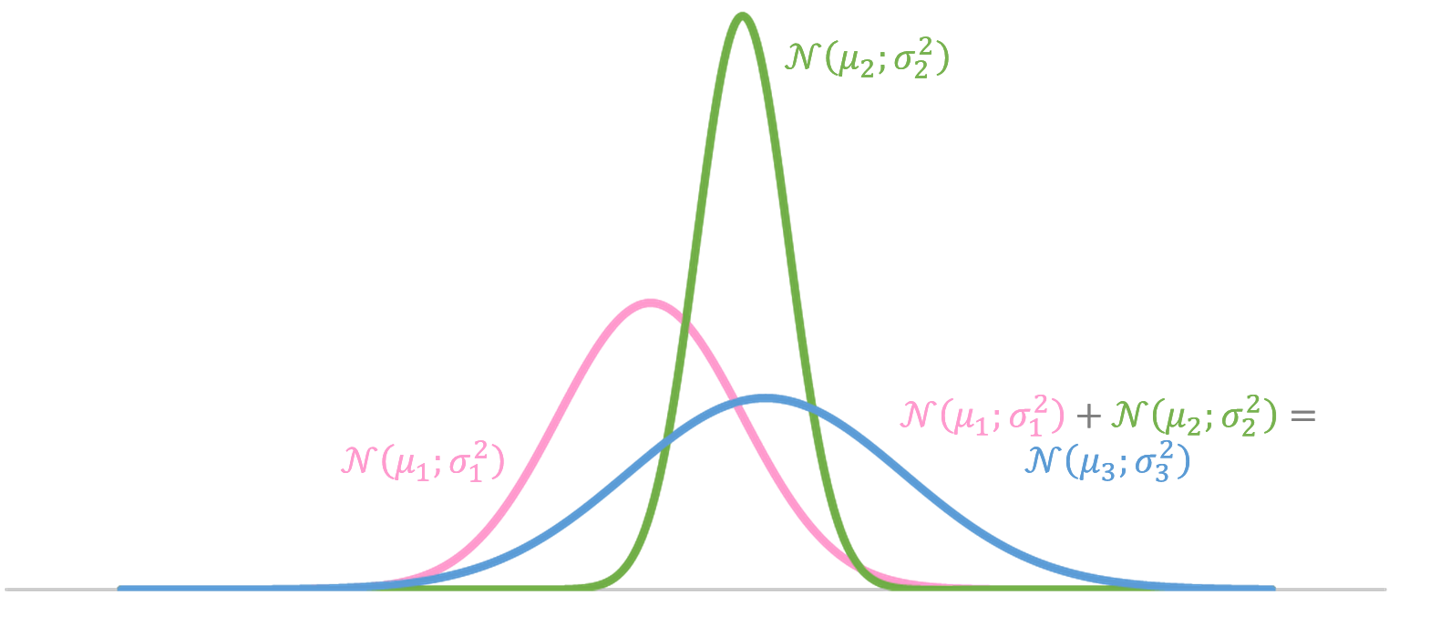
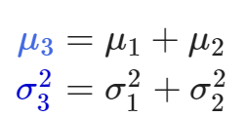
the sum of the gaussians are also gaussians...

Slide 19
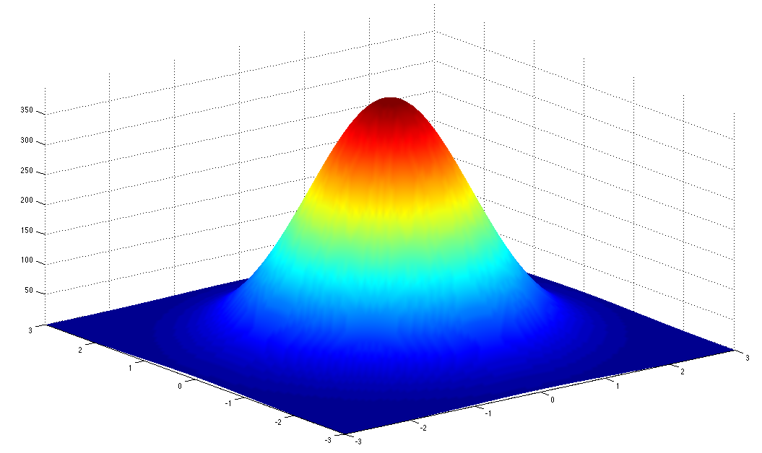

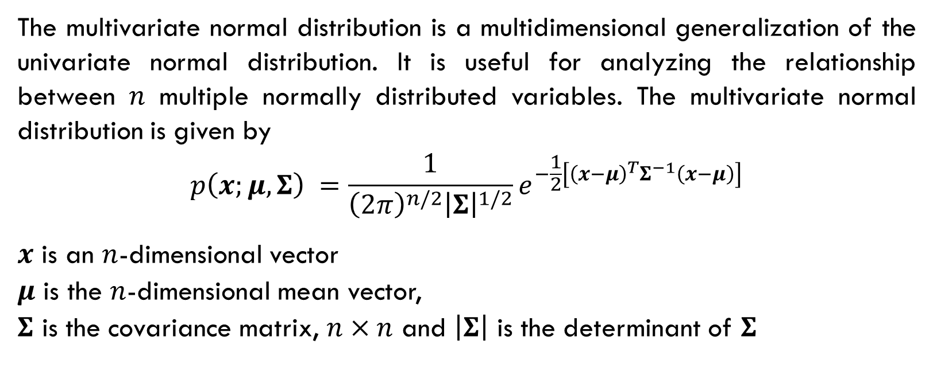
Multivariate Gaussian Distribution
$p\left(x;μ,σ^{2}\right)=\frac{1}{σ\sqrt{2π}}e^{−\frac{1}{2}{\left(\frac{x−μ}{σ}\right)}^{2}}$
The multivariate normal distribution is a multidimensional generalization of the univariate normal distribution. It is useful for analyzing the relationship between 𝑛 multiple normally distributed variables. The multivariate normal distribution is given by
$$p\left(x;μ,Σ\right) =\frac{1}{{\left(2π\right)}^{n/2}{\left|Σ\right|}^{1/2}}e^{−\frac{1}{2}\left[{\left(x−μ\right)}^{T}Σ^{−1}\left(x−μ\right)\right]}$$
$x$ is an $n$-dimensional vector
$μ$ is the $n$-dimensional mean vector,
$Σ$ is the covariance matrix, $n×n$ and $\left|Σ\right|$ is the determinant of $Σ$

Slide 20
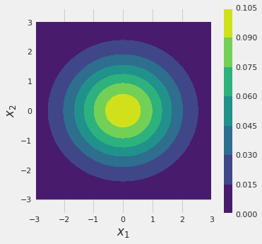
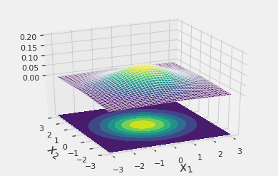
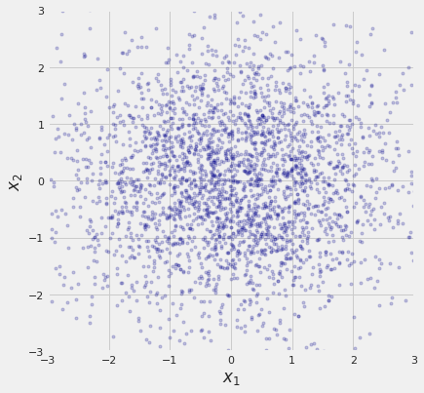

example
$$μ=\left({0. \atop 0.}\right) Σ=\left(\begin{matrix}1.7 & 0. \\ 0. & 1.3\end{matrix}\right)$$

Slide 21
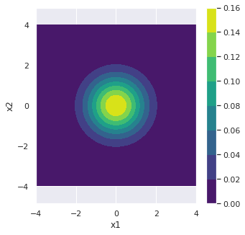
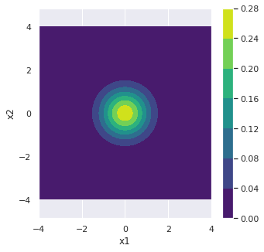
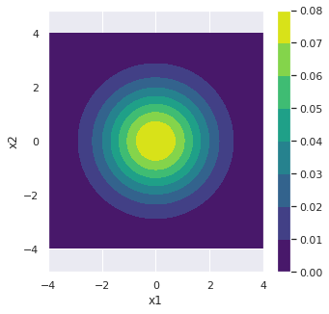
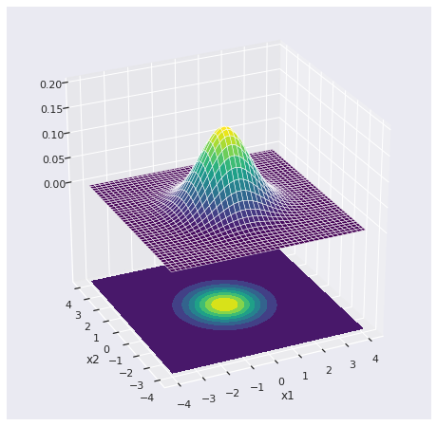
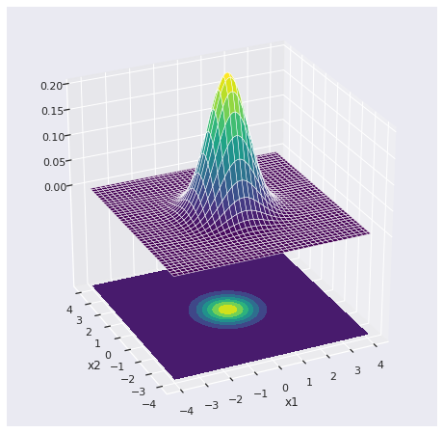
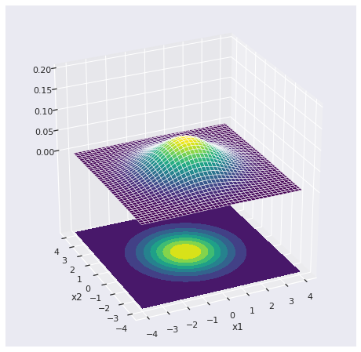
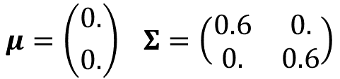
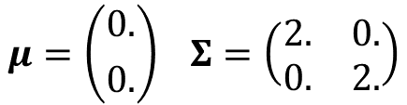
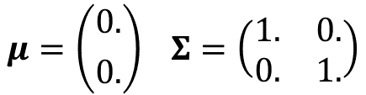
$$μ=\left({0. \atop 0.}\right) Σ=\left(\begin{matrix}1. & 0. \\ 0. & 1.\end{matrix}\right)$$
$$μ=\left({0. \atop 0.}\right) Σ=\left(\begin{matrix}0.6 & 0. \\ 0. & 0.6\end{matrix}\right)$$
$$μ=\left({0. \atop 0.}\right) Σ=\left(\begin{matrix}2. & 0. \\ 0. & 2.\end{matrix}\right)$$

Slide 22

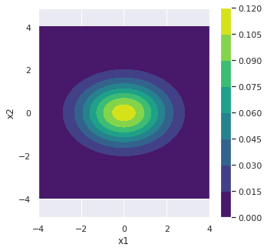
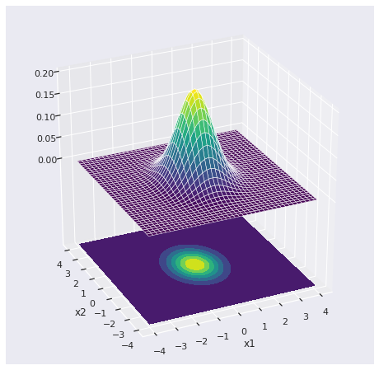
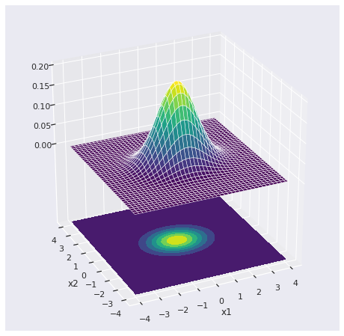
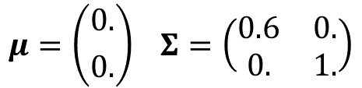
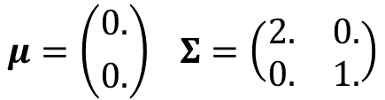
$$μ=\left({0. \atop 0.}\right) Σ=\left(\begin{matrix}1. & 0. \\ 0. & 1.\end{matrix}\right)$$
$$μ=\left({0. \atop 0.}\right) Σ=\left(\begin{matrix}0.6 & 0. \\ 0. & 1.\end{matrix}\right)$$
$$μ=\left({0. \atop 0.}\right) Σ=\left(\begin{matrix}2. & 0. \\ 0. & 1.\end{matrix}\right)$$

Slide 23

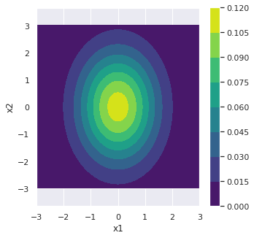
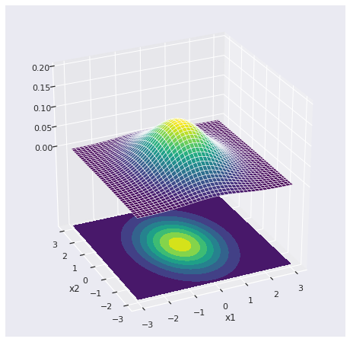
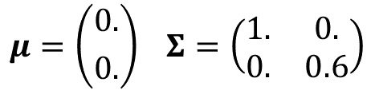
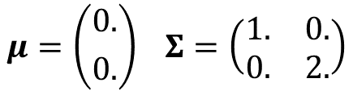
$$μ=\left({0. \atop 0.}\right) Σ=\left(\begin{matrix}1. & 0. \\ 0. & 1.\end{matrix}\right)$$
$$μ=\left({0. \atop 0.}\right) Σ=\left(\begin{matrix}1. & 0. \\ 0. & 0.6\end{matrix}\right)$$
$$μ=\left({0. \atop 0.}\right) Σ=\left(\begin{matrix}1. & 0. \\ 0. & 2.\end{matrix}\right)$$

Slide 24
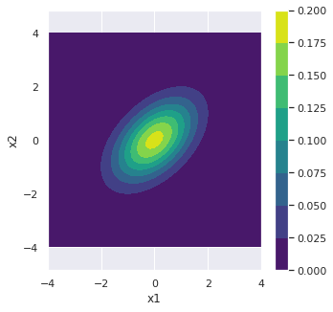
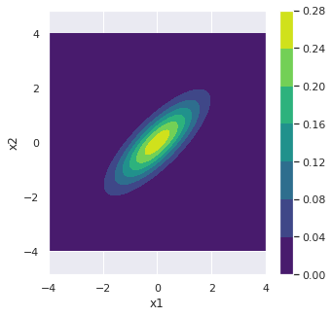
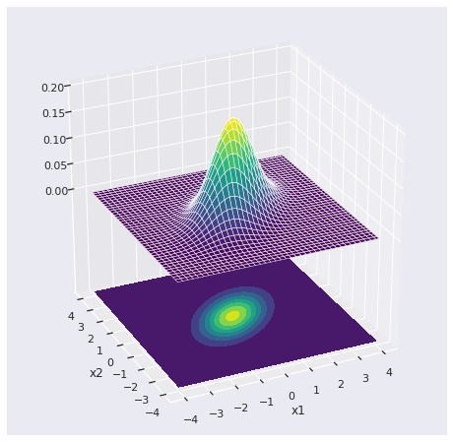



$$μ=\left({0. \atop 0.}\right) Σ=\left(\begin{matrix}1. & 0. \\ 0. & 1.\end{matrix}\right)$$
$$μ=\left({0. \atop 0.}\right) Σ=\left(\begin{matrix}1. & 0.5 \\ 0.5 & 1.\end{matrix}\right)$$
$$μ=\left({0. \atop 0.}\right) Σ=\left(\begin{matrix}1. & 0.8 \\ 0.8 & 1.\end{matrix}\right)$$

Slide 25






$$μ=\left({0. \atop 0.}\right) Σ=\left(\begin{matrix}1. & 0. \\ 0. & 1.\end{matrix}\right)$$
$$μ=\left({0. \atop 0.}\right) Σ=\left(\begin{matrix}1. & −0.5 \\ −0.5 & 1.\end{matrix}\right)$$
$$μ=\left({0. \atop 0.}\right) Σ=\left(\begin{matrix}1. & −0.8 \\ −0.8 & 1.\end{matrix}\right)$$

Slide 26







$$μ=\left({0. \atop 0.}\right) Σ=\left(\begin{matrix}1. & 0. \\ 0. & 1.\end{matrix}\right)$$
$$μ=\left({0. \atop 2.0}\right) Σ=\left(\begin{matrix}1. & 0. \\ 0. & 1.\end{matrix}\right)$$
$$μ=\left({1.5 \atop −1.0}\right) Σ=\left(\begin{matrix}1. & 0. \\ 0. & 1.\end{matrix}\right)$$

Slide 27







Unlikely Very likely
Position variance $σ_{p}^{2}$
position
position
Average $μ$
Velocity variance $σ_{v}^{2}$
Some state that might be true
velocity
velocity

Slide 28

KALMAN FILTER
To begin with, the Kalman Filter is a linear, unbiased estimator that uses a predictor/corrector process to estimate the state given a sequence of measurements.
This means that the overall process involves predicting the state and then correcting it based on the difference between that prediction and the observed measurement. The question becomes how to update the state prediction with the observed measurement, such that the resulting state estimate ${\hat{x}}_{k}$ is:
a linear combination of the predicted state ${\overline{x}}_{k}$ and the observed measurement $z_{k}$
have an error with zero mean (unbiased).

Slide 29

Suppose the robot moves along the horizontal axis – a situation that helps us illustrate the Kalman filter algorithm for a simplistic one-dimensional localization scenario.

Slide 30

The prediction about the robot's location is given by a normal distribution, where the predicted position is centered on the peak of the Gaussian.

Slide 31

The robot queries its sensor about its location and returns a measurement that is centered on the peak of the bold Gaussian and the Gaussian width corresponds to the uncertainty in the measurement.

Slide 32

Combining the measurement result with the process produces the bold Gaussian. The mean of this belief is between the two original means, and its radius of uncertainty is smaller than both contributing Gaussians.

Slide 33

Next, the robot moves to the right. Its uncertainty increases, corresponding to the Gaussian shown in bold.

Slide 34

Then the robot receives a second measurement illustrated by the Gaussian in bold.

Slide 35

The combination again leads to the posterior response…

Slide 36






Correction
Measurement
PDF
Prediction
With uncertainty $Q$
$$𝒩\left({\hat{x}}_{t},{\hat{P}}_{t}\right)$$
$$𝒩\left({\overline{x}}_{t+1},{\overline{P}}_{t+1}\right)$$
$$𝒩\left({\hat{x}}_{t+1},{\hat{P}}_{t+1}\right)$$
$$𝒩\left(z_{t+1},R\right)$$
Prediction
(motion model)
Measurement
(observation model)
Estimate
t
Estimate
t+1

Slide 37
Predict
Use the process model to predict the state at the next time step.
Adjust belief to account for uncertainty in the prediction..
Correction
Measurement
PDF
Prediction
With uncertainty $Q$
$$𝒩\left({\hat{x}}_{t},{\hat{P}}_{t}\right)$$
$$𝒩\left({\overline{x}}_{t+1},{\overline{P}}_{t+1}\right)$$
$$𝒩\left({\hat{x}}_{t+1},{\hat{P}}_{t+1}\right)$$
$$𝒩\left(z_{t+1},R\right)$$
Prediction
(motion model)
Measurement
(observation model)
Estimate
t
Estimate
t+1

Slide 38
Update
Get a measurement and its accuracy;
Calculate the residual between the estimated state and the measurement;
Calculate gain based on relative accuracy between measurement and prediction;
Set the state between prediction and measurement based on gain;
Update belief in the state based on measurement certainty.
Correction
Measurement
PDF
Prediction
With uncertainty $Q$
$$𝒩\left({\hat{x}}_{t},{\hat{P}}_{t}\right)$$
$$𝒩\left({\overline{x}}_{t+1},{\overline{P}}_{t+1}\right)$$
$$𝒩\left({\hat{x}}_{t+1},{\hat{P}}_{t+1}\right)$$
$$𝒩\left(z_{t+1},R\right)$$
Prediction
(motion model)
Measurement
(observation model)
Estimate
t
Estimate
t+1

Slide 39
Tracking
def compute_robot_data(z_var, process_var, count=1, dt=1.):
"returns track, measurements 1D ndarrays"
x, vel = 10., 3.
z_std = math.sqrt(z_var)
p_std = math.sqrt(process_var)
xs, zs = [], []
for _ in range(count):
v = vel + (randn() * p_std)
x += v*dt
xs.append(x)
zs.append(x + randn() * z_std)
return np.array(xs), np.array(zs)
Initial position and velocity
Standard deviation for
measurement and process
Generation of
real positions
Data stored in xs
Generation of
measurements.
Data stored in zs

Slide 40

xs,zs = compute_robot_data(z_var=1, process_var=10, count=100, dt=0.1)

Slide 41












$x$ is the true state of our system
measurement $z$
Measurement noise and process noise are statistically independent (uncorrelated) and
Gaussian Noise
$B,u$ related to control.
$u$ input vector.
Observation matrix $H$
Uncertainty in the measurement $R$
Uncertainty in the process $Q$
State transition function $F$

Slide 42





$\overline{x}$is the a priori predicted state vector, which is predicted without knowing the current measurement $z$.
$x$ is the true state of our system
measurement $z$
Gaussian Noise
$B,u$ related to control.
$u$ input vector.
When $z$ is given, the posterior state $\hat{x}$ can be calculated.
Observation matrix $H$
Kalman gain $K$
State transition function $F$

Slide 43








Predict E update
MEASUREMENT $z_{t+1}$
STATE
NEW POSTERIOR
${\hat{x}}_{t+1}={\overline{x}}_{t+1}+K_{t+1}y_{t+1}$
${\hat{P}}_{t+1}=\left(I−K_{t+1}H\right){\overline{P}}_{t+1}$
RESIDUAL $y_{t+1}$
$$y_{t+1}=z_{t+1}−H{\overline{x}}_{t+1}$$
(Process model)
PREDICTION
PRIOR ${\overline{x}}_{t+1},{\overline{P}}_{t+1}$
POSTERIOR ${\hat{x}}_{t}$,${\hat{P}}_{t}$
TIME

Slide 45
PREDICTION STEP
The process model is applied
Uncertainty increases

Slide 46


Multidimensional Prediction
We design the state (x,P), the process (F,Q) and the control (B,u)

Slide 47


State variables
State variables can be either observed variables – measured directly by a sensor, or hidden variables – inferred from observed variables.
For our robot tracking problem, the sensor just reads the position, so the position is observed and the speed is hidden.

Slide 48




STATE COVARIANCE
If we are quite uncertain about the initial position.
Top speed for our robot is around $3 m/s$, so in the absence of any other information about the velocity we can set $σ_{v}^{2}≈\frac{1}{3}v$
Position and velocity are correlated. But how correlated are they to the robot? No idea!
As we will see, the filter calculates this for us. We can therefore initialize the covariances to zero. Of course, if we know the covariances, we should use them.

Slide 49




Modelo de Processo
Of course, this is not exactly true, but as long as the velocity doesn’t change too much during each prediction, you will see that the filter performs very well
We assume that the robot's speed stays constant between predictions.

Slide 50

dt = 0.1
x = np.array([10.0, 3.0])
P = np.diag([500, 1])
F = np.array([[1, dt], [0, 1]])
Q=0 # Q is the process noise
x = F @ x
P = F @ P @ F.T + Q
print('x =', x)
Implementation of the prediction step
from filterpy.kalman import predict
x = np.array([10.0, 3.0])
P = np.diag([500, 1])
F = np.array([[1, dt], [0, 1]])
x, P = predict(x=x, P=P, F=F, Q=0)
print('x =', x)
Using Filterpy
Qual será a resposta???
x = [10.3 3.]

Slide 51

for _ in range(4):
x, P = predict(x=x, P=P, F=F, Q=0)
print('x =', x)
x = [10.6 3. ]
x = [10.9 3. ]
x = [11.2 3. ]
x = [11.5 3. ]
Off-diagonal elements became non-zero - the Kalman filter detected a correlation between position and velocity!
print(P)
[[5.0025e+02 5.0000e-01]
[5.0000e-01 1.0000e+00]]
Inspection of the diagonals shows us that the position variance has increased. We performed five prediction steps without measurements and our uncertainty increased. The speed variance has not changed.
See what happens in the Notebook!

Slide 52

Process noise 𝑸
However, the speed is affected by a number of unknown factors and as a consequence the cruise control is unable to maintain a perfectly constant speed.
There are many unknown factors – hills, curves, changes in the coefficient of drag, the effects of wind, rain, and so on…
A car is driving on the road with the cruise control on and must travel at a constant speed.
PMR3408

Slide 53

Process noise 𝑸
In general, the design of the 𝑸 matrix is among the most difficult aspects of Kalman filter design.
We are trying to model the noise of something we have little information about.
PMR3408

Slide 54
Process noise 𝑸
In general, the design of the 𝑸 matrix is among the most difficult aspects of Kalman filter design. We are trying to model the noise of something we have little information about.
If 𝑸 is too small, the filter will become overconfident in its prediction model and diverge from the actual solution.
If 𝑸 is too large, the filter will be unduly influenced by noise in the measurements and will perform suboptimally.
In practice, we spend a lot of time running simulations and evaluating the data collected to try to select an appropriate value for 𝑸.

Slide 55

Piecewise white noise matrix
The model assumes that the highest-order term (acceleration) remains constant over a given time interval and is uncorrelated across different time intervals. In other words, there is a discontinuous jump in acceleration at each time step.
𝚪 is the noise gain of the system and constant 𝜔 is the piecewise acceleration

Slide 56


Piecewise white noise matrix
The model assumes that the highest-order term (acceleration) remains constant over a given time interval and is uncorrelated across different time intervals. In other words, there is a discontinuous jump in acceleration at each time step.
Over a time interval, the change in velocity will be $ω(t)Δt$, and the change in position will be $ω\left(t\right){Δt}^{2}/2$ , such that

Slide 57



$Q$ Matrix

Slide 58

$Q$ Matrix

Slide 59

Matriz $Q$

Slide 60


$Q$ Matrix
A good rule of thumb is to set σ_{a} close to $\frac{1}{6}$Δa to Δa , where Δa is the maximum change that the acceleration can undergo between sampling periods.
In practice, we choose a number, run simulations on the data, and choose a value that works well.

Slide 61


var = 2.
dt = 1
Tvector = np.array([[dt**2 / 2], [dt]])
Q = Tvector * var * Tvector.T
print(Q)
Calcula a matriz $Q$
Import the function Q_discrete_white_noise function to calculate the matrix $Q$.
from filterpy.common import Q_discrete_white_noise
Q = Q_discrete_white_noise(dim=2, dt=1., var=2.)
print(Q)
Call the function
[[0.5 1. ]
[1. 2. ]]

Slide 62
B = 0.
u = 0
dt = 0.3
F = np.array([[1, dt], [0, 1]])
x = np.array([10.0, 4.5])
P = np.diag([500, 500])
x, P = predict(x, P, F, Q, B, u)
print('x =', x)
print('P =', P)
Our robot does not listen to us...
Call the function
x = [11.35 4.5 ]
P = [[545.5875 151.175 ]
[151.175 502.35 ]]

Slide 63




$$H_{t}{\overline{x}}_{t+1}$$
In the next step, we should try to adjust our guess. We have the predicted state and now, the sensor reading.
Sensor 2
$$z_{t+1}$$
Sensor 1

Slide 64
UPDATE STEP
Importance of gain

Slide 65









UPDATE
Observation matrix $H$
residue $y$
We define $H$so that $H\overline{x}$ has the same unit as the measurement.
Kalman gain $K$
Covariance, measurement noise $R$
We will define the measurement (z,R) and the observation matrix H

Slide 66


$H$ matrix
For this problem we have a sensor that measures the position

Slide 67





$P$ matrix
Estimation error is the difference between the true state and the estimated state
Covariance matrix $P$
A miracle happened here...
See the miracle in the Notebook!

Slide 68



gain $K$
The Kalman gain $K$ is determined by minimizing the squared error, so we need the derivative of the trace of $P$, with respect to $K$ ,

Slide 69




Here, another miracle happens...

Slide 70



Slide 71




Ganho
Measurement uncertainty
State uncertainty in the prediction

Slide 72



Kalman gain for $x$
Kalman gain for $\dot{x}$
What is the effect of this?

Slide 73





If the position estimate were the same as the measurement…
The residual would be $y=0$ and the position/velocity estimate would not change.

Slide 74




If the position estimate was really bad…
The prediction$\overline{x}$ was very different from the measurement, $y≫0$, so the position and velocity values are updated.

Slide 75

If the position estimate was really bad…
The higher$K_{x}$, the greater the correction, as the more reliable the measurement is in relation to the prediction.
The greater the correlation, the greater the speed correction.

Slide 76



PREDICT
UPDATE

Slide 77

Input data for our filter
dt = 1.
R_var = 10
Q_var = 0.01
x = np.array([[10.0, 3.0]]).T
P = np.diag([500, 1])
F = np.array([[1, dt],
[0, 1]])
H = np.array([[1., 0.]])
R = np.array([[R_var]])
Q = Q_discrete_white_noise(dim=2, dt=dt, var=Q_var)

Slide 78
count = 50
track, zs = compute_robot_data(R_var, Q_var, count)
xs, cov = [], []
for z in zs:
# predict
x = F @ x
P = F @ P @ F.T + Q
#update
S = H @ P @ H.T + R
K = P @ H.T @ np.linalg.inv(S)
y = z - H @ x
x += K @ y
P = P - K @ H @ P
xs.append(x)
cov.append(P)
xs, cov = np.array(xs), np.array(cov)
plot_track(xs[:, 0], track, zs, cov, plot_P=False)
Movement
simulation
Prediction
Update
Data storage update
vectors with new
state and cov.

Slide 79


Slide 80
from filterpy.kalman import KalmanFilter
Poli_filter = KalmanFilter(dim_x=2, dim_z=1)
print('x = ', Poli_filter.x.T)
print('R = ', Poli_filter.R)
print('Q = \n', Poli_filter.Q)
# etc...
Creation of the Robot
Poli
x = [[0. 0.]]
R = [[1.]]
Q = [[1. 0.]
[0. 1.]]

Slide 81
from filterpy.kalman import KalmanFilter
from filterpy.common import Q_discrete_white_noise
def pos_vel_filter(x, P, R, Q=0., dt=1.0):
""" Returns a KalmanFilter which implements a
constant velocity model for a state [x dx].T
"""
kf = KalmanFilter(dim_x=2, dim_z=1)
kf.x = np.array([x[0], x[1]]) # location and velocity
kf.F = np.array([[1., dt],
[0., 1.]]) # state transition matrix
kf.H = np.array([[1., 0]]) # Measurement function
kf.R *= R # measurement uncertainty
if np.isscalar(P):
kf.P *= P # covariance matrix
else:
kf.P[:] = P # [:] makes deep copy
if np.isscalar(Q):
kf.Q = Q_discrete_white_noise(dim=2, dt=dt, var=Q)
else:
kf.Q[:] = Q
return kf
Instancie o filtro
Set correct values for matrices and vectors.

Slide 82
def run(x0=(0.,0.), P=500, R=0, Q=0, dt=1.0,track=None, zs=None,
count=0, do_plot=True, **kwargs):
"""
track is the actual position of the robor, zs are the
corresponding measurements.
"""
# Simulate robot if no data provided.
if zs is None:
track, zs = compute_robot_data(R, Q, count)
# create the Kalman filter
kf = pos_vel_filter(x0, R=R, P=P, Q=Q, dt=dt)
# run the kalman filter and store the results
xs, cov = [], []
for z in zs:
kf.predict()
kf.update(z)
xs.append(kf.x)
cov.append(kf.P)
xs, cov = np.array(xs), np.array(cov)
if do_plot:
plot_track(xs[:, 0], track, zs, cov, **kwargs)
return xs, cov
Check whether measurement data in zs has been provided. Otherwise, create the data using our compute_robot_data..
create the Kalman filter
perform the Kalman filter update and prediction steps for each measurement
Plot the results, then return the saved states and covariances

Slide 83


Slide 84


Slide 85


Slide 86
There is still a lot to learn, but we have implemented a Kalman filter using the same theory and equations published by Rudolf Kalman! Code much like this runs inside your GPS, airplanes, robots, and so on.

Slide 87


Hands on
Simple exercises, not mandatory, but they will provide the necessary knowledge for the filter... In short: if I were you, I would do them...

Slide 88

Adjusting the filter
Consider that our robot has real values of measurement variance $σ_{z}=200 m^{2}$and process variance $σ_{a}=0.03 m^{2}.$ To see the effects of measurement noise $R$ and process noise $Q$, the following exercises are proposed :
for a constant measurement variance of 200 $m^{2}$ (constant$R$at a very large value will serve to magnify the effects of various design choices on the graphs, making it easier to recognize what is happening), test the process variances of $\text{3}\text{0}\text{0} m^{2}$ and $\text{0.03 }m^{2}$;
With the actual process and measurement variance values, change the initial position to 50 $m$ and the initial velocity to 1 $m/s$ to see how the filter behaves with a poor initial estimate;
set the process variation to 0.2 $m^{2}$, and increase the measurement variation to 10000 $m^{2}$;
With the data defined as in item 3, change the initial position to 50 𝑚 and the initial velocity to 1 𝑚/𝑠 to see how the filter will behave with a bad initial estimate.

Slide 89


Slide 90


Slide 91


Slide 92


Slide 93


Homework 01 (optional)
For the path measured by the GPS shown in the figure below, use the Kalman filter and trace the trajectory of the vehicle.
Use the variance data and initial estimates defined in the Notebook.

Slide 94
EKT: Extended Kalman Filter
It's not all sunshine and roses…

Slide 95
Kalman Filter theory
The Kalman filter theory proposed by R. Kalman has two strong assumptions:
The Kalman Filter will always work with Gaussian Distribution;
The Kalman Filter will always work with Linear Functions.
What if my function is no longer linear? The solution is to make them linear by approximation. After applying the approximation, what we get is an Extended Kalman Filter, or EKF.
In EKF, the transition models (which define the matrix F) and state observation (which define the matrix H) do not need to be linear functions of the state, but can be differentiable functions.

Slide 96


Slide 97

O-ho. Most real-world problems involve nonlinear functions. For example, in many cases, the system is looking in one direction and taking measurements in another direction. This involves angles and sine and cosine functions, which are non-linear functions...

Slide 98

Prediction:
Correction:

Slide 99







Your challenge...
$$m$$
where $θ$ is the angle with the horizontal axis and $\dot{θ}$ is the angular velocity. The Lagrangian derivation of the simple pendulum equations of motion yields:
$$ml^{2}\ddot{θ}\left(t\right)=G−mgl\cos{θ(t)}$$
Where $G=−c\dot{θ}\left(t\right)+u(t)$
$$l$$
$$g$$
$$θ$$
A gyroscope detects angular velocity $\dot{θ}$.

Slide 100
Simulation of the real behavior of the pendulum and the measurement process
def dynamics_evolution(x, u):
'''
returns the new state i+1, given the previous state i added to random process noise q
'''
return A.dot(x) + B*(-np.cos(x[0])*m*g*l-c*x[1] + u + np.random.normal(0,np.sqrt(q)))
def measurement(x):
'''
returns measurement added to random sensor noise r
'''
return x[1] + np.random.normal(0,np.sqrt(r))
Pendulum movement
Speed measurement

Slide 101

Class Observer
class Observer():
def __init__(self, initial_state, initial_covariance):
self._xb = np.array(initial_state)
self._xh = np.array(initial_state)
self._Pb = np.array(initial_covariance)
self._Ph = np.array(initial_covariance)
def FMatrix(self, state):
pass
def prediction(self, u):
pass
def correction(self, z):
pass
def predicted_corrected(self):
return self._xh
Check the preservation of the initial nomenclature x bar, x hat.
Your homework
$$θ_{0}≅\frac{π}{2}$$

Slide 102





Inverted pendulum
Without control, verification of the real movement of the pendulum
Control using the actual position of the pendulum as feedback
Without control, verification of the pendulum movement from the perspective of the Kalman Filter (process+sensor)
Control using Kalman filter feedback

Slide 103
Inverted pendulum
Without control, verification of the real movement of the pendulum
Control using the actual position of the pendulum as feedback
Without control, verification of the pendulum movement from the perspective of the Kalman Filter (process+sensor)
Control using Kalman filter feedback

Slide 104
CONTROL Class Control_Empty()
class Control_Empty():
def __init__(self):
pass
def observe(self, x, z):
return np.zeros(2)
def action(self):
return 0
Uncontrolled system (like our robot).
The pendulum is free, starting from the position π/2 and then descending.

Slide 105


Slide 106
Inverted pendulum
Without control, verification of the real movement of the pendulum
Control using the actual position of the pendulum as feedback
Without control, verification of the pendulum movement from the perspective of the Kalman Filter (process+sensor)
Control using Kalman filter feedback

Slide 107
CONTROL CLASS: Control_PIDwithState()
class Control_PIDwithState():
def __init__(self, kp, kd):
self._kp = kp
self._kd = kd
def observe(self, x, z):
self._state = x
return x
def action(self):
return self._kp*(np.pi/2-self._state[0])-self._kd*self._state[1]
Observed state is exactly the real state of the system.
PID control

Slide 108


Slide 109
Inverted pendulum
Without control, verification of the real movement of the pendulum
Control using the actual position of the pendulum as feedback
Without control, verification of the pendulum movement from the perspective of the Kalman Filter (process+sensor)
Control using Kalman filter feedback

Slide 110
Control class: Control_EmptyWithObserver()
class Control_EmptyWithObserver():
def __init__(self, initial_state, initial_covariance):
self._observer = Observer(initial_state, initial_covariance)
self._last_action = 0
def observe(self, x, z):
self._observer.prediction(self._last_action)
self._observer.correction(z)
return self._observer.predicted_corrected()
def action(self):
return 0
Observed state is Kalman result
Uncontrolled...

Slide 112
Inverted pendulum
Without control, verification of the real movement of the pendulum
Control using the actual position of the pendulum as feedback
Without control, verification of the pendulum movement from the perspective of the Kalman Filter (process+sensor)
Control using Kalman filter feedback

Slide 113
Control Class: Control_PIDwithObserver()
class Control_PIDwithObserver():
def __init__(self, kp, kd, initial_state, initial_covariance):
self._observer = Observer(initial_state, initial_covariance)
self._last_action = 0
self._kp = kp
self._kd = kd
def observe(self, x, z):
self._observer.prediction(self._last_action)
self._observer.correction(z)
return self._observer.predicted_corrected()
def action(self):
state = self._observer.predicted_corrected()
self._last_action = self._kp*(np.pi/2 - state[0]) - self._kd*state[1]
return self._last_action
Observed state is Kalman result
Control...

Slide 114


Slide 115
simulation
def simulation(x0, controller):
x = x0
z = measurement(x)
prediction = controller.observe(x, z)
u = controller.action()
yield z, u, x, prediction
while True:
x = dynamics_evolution(x, u)
prediction = controller.observe(x, z)
u = controller.action()
z = measurement(x)
yield z, u, x, prediction
Initial values of state (x0), measurement (z), Kalman prediction (prediction) and control (u)
Evolution for each new state until simulation of N time intervals.

Slide 116
Let's try to use what we learned...
outputs = []
states = []
predictions = []
actions = []
for z, u, x, e in list(itertools.islice(simulation(np.array([np.pi/2 - 0.1, 0]), Control_Empty()), 10000)):
outputs.append(z)
states.append(x)
actions.append(u)
predictions.append(e)
outputs = np.array(outputs)
states = np.array(states)
actions = np.array(actions)
predictions = np.array(predictions)
plt.plot(states[:,0])
plt.plot(outputs[:,0]);

Slide 117

homework 02
Block Diagram: There will be a designated area in Moodle for submitting your block diagram as an image (JPEG or PNG).
Coding Task: Complete the code to generate the results demonstrated in class.

Slide 118
FIM

